Slide 1

Removing correlation anomalies to achieve a highest level of accuracy
Jose Carlo Burga

Slide 2
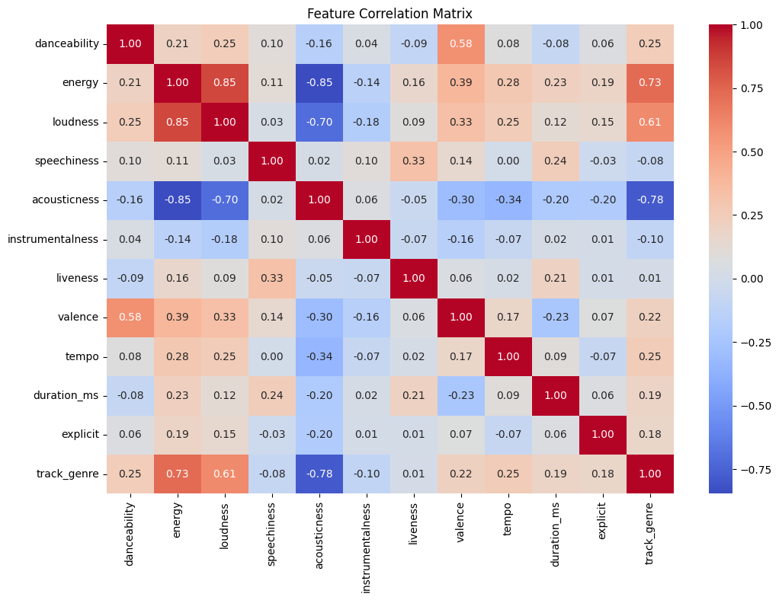
Top Correlation Anomalies: - Acousticness - Energy - Loudness
Feature Correlation Matrix

Slide 3
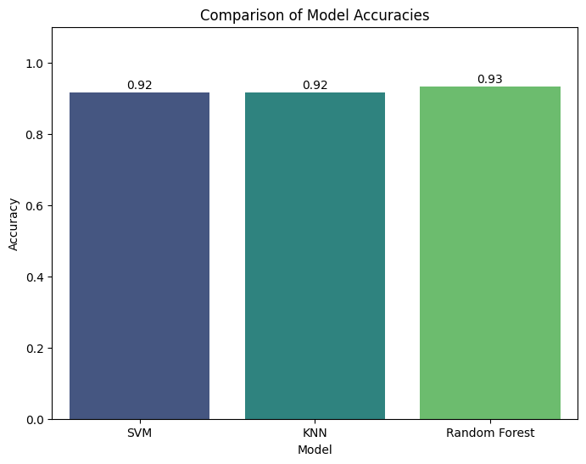
Experiment 1: What if I don’t remove any anomalies

Slide 4
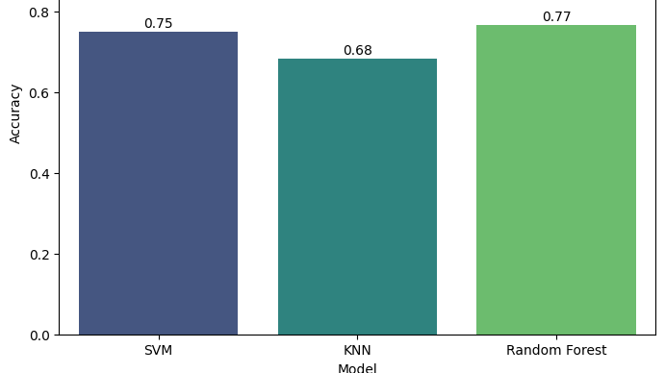
Experiment 2: What if I remove the top three anomalies

Slide 5
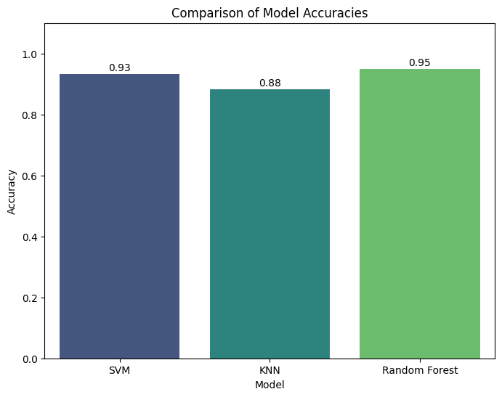
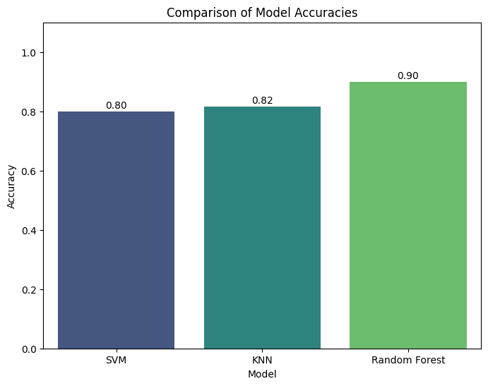
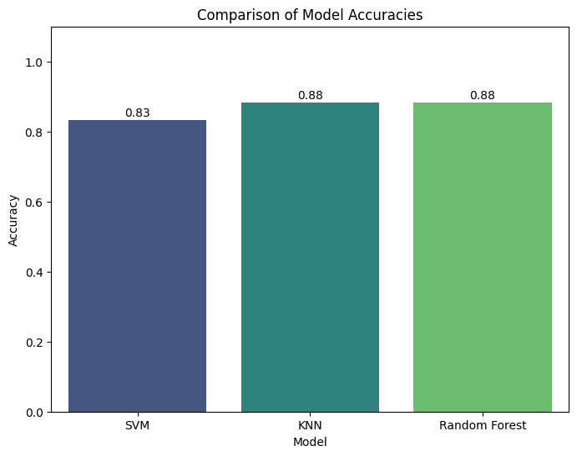
Experiment 3: What if I remove Two anomalies at a time
Energy & Loudness
Energy & Acousticness
Loudness & Acousticness

Slide 6
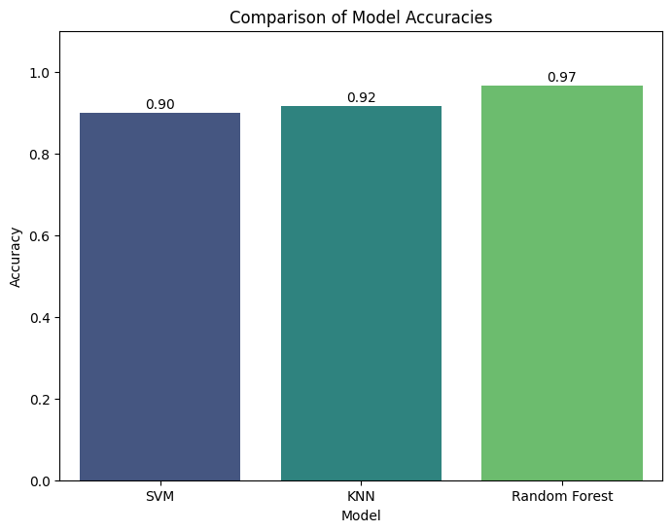
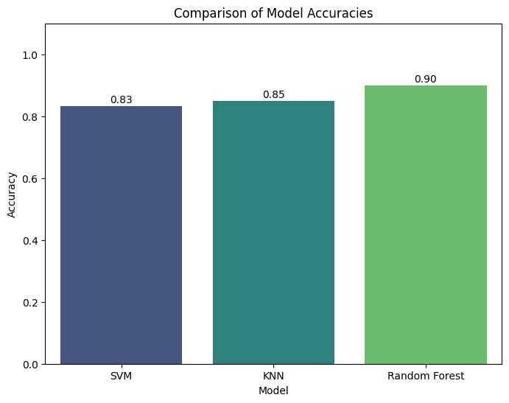

Experiment 4: What if I remove one anomaly at a time
Energy
Acousticness
Loudness

Slide 7
model with the highest level of accuracy Across Experiments: Random Forest: Removing Correlation Anomalies
Experiment 2: Removing ‘energy’
- Remove one highly correlated feature with a correlation around |0.7| or higher.
- Remove and then re-train your models.
- Note any differences compared to the baseline.

Slide 8
model with the highest level of accuracy Across Experiments: Random Forest: Removing Correlation Anomalies
Random forest run the highest level of accuracy across 4 different
experiments testing the 3 highest correlated features (‘energy’, ‘loudness’, and ‘acousticness’)
Experiment 1: Baseline (all features included)
Experiment 2: Removing the top three correlation anomalies
Experiment 3A: Removing two correlation anomalies at a time (‘energy’, ‘loudness’)
Experiment 3B: Removing two correlation anomalies at a time (‘energy’ and ‘acousticness’)
Experiment 3C: Removing two correlation anomalies at a time ( ‘loudness’ and ‘acousticness’)
Experiment 4A: Removing one correlation anomaly at a time (‘acousticness’)
Experiment 4B: Removing one correlation anomaly at a time ( ‘energy’)
Experiment 4C: Removing one correlation anomaly at a time ( ‘loudness’)
Removing correlation anomalies to achieve a highest level of accuracy
Click here for the experiment notebooks in GitHub
Experiment 2: Removing ‘energy’
- Remove one highly correlated feature with a correlation around |0.7| or higher.
- Remove and then re-train your models.
- Note any differences compared to the baseline.

